Slide 1
Java Basic 4

Slide 2
Packages
A package is nothing but a physical folder structure (directories) that contains a group of related classes, interfaces, and sub-packages according to their functionality.
It provides a convenient way to organize your work. The Java language has various in-built packages.
For example, java.lang, java.util, java.io, and java.net. All these packages are defined as a very clear and systematic packaging mechanism for categorizing and managing.

Slide 3
Advantages of using Packages in Java
1. Maintenance: Java packages are used for proper maintenance. If any developer newly joined a company, he can easily reach to files needed.
2. Reusability: We can place the common code in a common folder so that everybody can check that folder and use it whenever needed.
3. Name conflict: Packages help to resolve the naming conflict between the two classes with the same name. Assume that there are two classes with the same name Student.java.
Each class will be stored in its own packages such as stdPack1 and stdPack2 without having any conflict of names.
4. Organized: It also helps in organizing the files within our project.
5. Access Protection: A package provides access protection. It can be used to provide visibility control.

Slide 4
Types of packages
1.User defined
2.Predefined or built-in
User defined
The package which is defined by the user is called a User-defined package. It contains user-defined classes and interfaces.

Slide 5
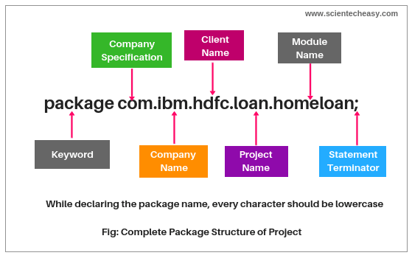


Naming convention to declare user defined package

Slide 6
Predefined packages
Predefined packages in java are those which are developed by Sun Microsystem. They are also called built-in packages in java.
These packages consist of a large number of predefined classes, interfaces, and methods that are used by the programmer to perform any task in his programs.

Slide 7
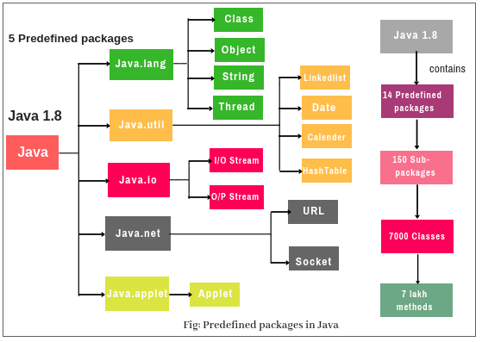

Slide 8
Core Packges
1. Java.lang: lang stands for language. The Java language package consists of java classes and interfaces that form the core of the Java language and the JVM. It is a fundamental package that is useful for writing and executing all Java programs.
Examples are classes, objects, String, Thread, predefined data types, etc. It is imported automatically into the Java programs.
2. Java.io: io stands for input and output. It provides a set of I/O streams that are used to read and write data to files. A stream represents a flow of data from one place to another place.
3. Java util: util stands for utility. It contains a collection of useful utility classes and related interfaces that implement data structures like LinkedList, Dictionary, HashTable, stack, vector, Calender, data utility, etc.
4. Java.net: net stands for network. It contains networking classes and interfaces for networking operations. The programming related to client-server can be done by using this package.

Slide 9
Some other packages
1. Java.awt: awt stands for abstract window toolkit. The Abstract window toolkit packages contain the GUI(Graphical User Interface) elements such as buttons, lists, menus, and text areas. Programmers can develop programs with colorful screens, paintings, and images, etc using this package.
2. Java.awt.image: It contains classes and interfaces for creating images and colors.
3. Java.applet: It is used for creating applets. Applets are programs that are executed from the server into the client machine on a network.
4. Java.text: This package contains two important classes such as DateFormat and NumberFormat. The class DateFormat is used to format dates and times. The NumberFormat is used to format numeric values.
5. Java.sql: SQL stands for the structured query language. This package is used in a Java program to connect databases like Oracle or Sybase and retrieve the data from them.

Slide 10
Importing package in Java
import package.*;
import package.classname;
Using fully qualified name.

Slide 11
Points to remember
1. Java predefined supports a group of packages that contains a group of classes and interfaces. These classes and interfaces consist of a group of methods.
For example, Java language contains a package called java.lang which contains string class, StringBuffer class, StringBuilder class, all wrapper classes, runnable interface, etc. String class contains a number of methods such as length(), toUpperCase(), toLowerCase() etc.
2. Java contains 14 predefined packages which are main packages. These 14 predefined packages contain nearly 150 sub-packages that consist of a minimum of 7 thousand classes. These 7 thousand classes contain approx 7 lakhs methods.
3. Up to Java 1.7 version contains 13 predefined packages. From Java 1.8 version onwards, one new package is introduced called java.time.

Slide 12
Access Specifier or modifier
a modifier limits the visibility of classes, constructor, variables,methods in the Java program.
Java language provides a total of 12 modifiers. They are public, private, protected, default, final, synchronized, abstract, native, strictfp, transient, and volatile.
Twelve modifiers in java can be divided into two categories:
Access modifiers
Non-access modifiers

Slide 13
access modifiers are those modifiers that are used to restrict the visibility (accessibility) of classes, fields, methods, or constructors.
In short, the accessibility/visibility of data depends on the access modifiers. The access modifiers are also known as visibility modifiers.
Java provides four explicit access modifiers in object-oriented programming languages. They are private, default, protected, and public.

Slide 14
Private
1. Private access modifier in java can apply to a variable, method, constructor, inner class but not the outer class that is class itself.
2. The instance variable can be private but a local variable cannot be private.
3. Private members (field, method, or constructor) of a class cannot be accessed from outside the class. They are accessible only within the class.
4. Private members of a superclass cannot be inherited to the subclass. Therefore, they are not accessible in subclasses.
5. If we make any constructor as private, we cannot create an object of that class from another class and also cannot create the subclass of that class.
6. A class cannot be private except for inner classes. Inner classes are members of the outer class. So, members of the class can be private.
7. If we declare a method as private, it behaves as a method declared as final. We cannot call the private method from outside the class.

Slide 15
Role of a private constructor
If we declare any constructor of a class as private then we cannot create an object of that class from outside the class. In other words, we cannot create the subclass of that class.

Slide 16
Default
1. When access modifier is not specified to members of a class or a class itself, it is called default access modifier.
2. The default can apply to the instance variable, local variable, constructor, methods, inner class, or outer class.
3. Default members of a class are visible inside of the class and everywhere within classes in the same package or folder only. Therefore, they can be accessed from outside the classes in the same package but can not be accessed outside the package.
4. Default members can be inherited to the subclass within the same package only. It cannot be inherited from outside the package.

Slide 17
protected
1. Protected access modifier can be applied to instance variables, local variables, constructors, methods, inner classes but not the outer class.
2. Protected members are accessible inside the class and everywhere within classes in the same package and outside the package but through inheritance only.
3. Protected members can be inherited to the subclass.
4. If we make constructor as protected then we can create the subclass of that class within the same package but not outside the package

Slide 18
public
1. Public access modifier can apply to instance variables, constructors, inner classes, outer class, methods but not with local variables.
2. Public members of a class can be used anywhere.
3. Public members of a class can be inherited to any subclass.
Private protected Access:
A variable or field can be declared with two keywords as private and protected together like this:
private protected int age;
It provides the visibility level in between the “protected access” and “private access”. This modifier makes the variable visible in all the subclasses regardless of what package they are in but the field cannot be accessed by other classes in the same package.

Slide 19
Visibility in access modifiers
Access location | Public | Protected | Default | Private protected | Private
Same class | Yes | Yes | Yes | Yes | Yes
Subclass in same package | Yes | Yes | Yes | Yes | No
Other classes in same package | Yes | Yes | Yes | No | No
Subclasses in other package | Yes | Yes | No | Yes | No
Non-subclasses in other packages | Yes | No | No | No | No

Slide 20
Applicable Modifiers with Classes, Methods, Variables, Interfaces
Outer class(Top level class)
1. The only five modifiers are applicable to the outer class. They are public, default, final, abstract, and strictfp.
2. Final and abstract both cannot be applied simultaneously with a class. It is an illegal combination.
3. If a class is declared as public, private, or protected cannot be applied simultaneously with public class. It is also an illegal combination.

Slide 21
Inner class
1. The applicable modifiers for the inner class are public, private, protected, default, final, abstract, static, and strictfp.
2. The non-applicable modifiers for inner class are synchronized, native, transient, and volatile.
3. The modifiers which are not applicable for inner classes but not applicable for outer classes are private, protected, and static.

Slide 22
Methods
1. The only two modifiers out of 12 that are not applicable for methods are transient and volatile.
2. If a method is declared as public, we cannot declare simultaneously private or protected with a public method.
3. If a method is defined as abstract, we cannot apply final, static, synchronized, native, private, or strictfp.

Slide 23
variables
1. The modifiers applicable for variables are public, protected, private, default, final, static, transient, and volatile.
2. The non-access modifiers such as abstract, synchronized, native, and strictfp are not applicable for variables.
3. The only applicable modifier with local variable is final. If a variable is declared as final, we cannot declare as volatile.

Slide 24
Constructors
1. For a constructor, only access modifiers are applicable. The access modifiers like public, protected, default, and private can be applied with constructors.
2. Non-access modifiers cannot be applied with constructors. By mistake, if you apply any other modifiers with constructor except these four access modifiers, you will get a compile-time error.
Blocks
1. Static and synchronized modifiers are only applicable for blocks.

Slide 25
Outer Interface:
1. Public, default, abstract, and strictfp are modifiers that are applicable for outer interface. Except for these modifiers, we cannot apply other modifiers with outer or top-level interface.
2. The non-access modifier that is applicable for classes but not applicable for an interface, is final.
Inner Interface:
1. For inner interface, we can apply modifiers like private, default, protected, public, abstract, static, and strictfp.
2. The non-access modifiers such as final, synchronized, native, transient, and volatile are not applicable for inner interface.

Slide 26
Outer Enum:
1. The only three modifiers like public, default, and strictfp are applicable for outer enum.
2. The modifiers which are applicable for classes but not applicable for enum are final and abstract.
Inner Enum:
1. For enum, we can apply all four access modifiers and two non-access modifiers like static, and strictfp.

Slide 27
Non access modifiers
Except access modifiers, all the remaining modifiers available in java are called non-access modifiers. They are abstract, final, native, static, strictfp, synchronized, transient, and volatile.

Slide 28
Abstract modifiers
1. Abstract is a keyword that can be applied with outer class,inner class, method, outer interface, and inner interface. It cannot be applied with variable, constructor, block, and enum.
2. When a class is declared with a keyword abstract, it is called abstract class in java.
3. An abstract keyword cannot be simultaneously declared with the final keyword.
4. An interface in java is by default abstract and does not need to be declared abstract.
5. When a method is declared with an abstract keyword, it is known as abstract method. It contains only a signature and no body. If you declare a method as abstract in a class, the class must be declared as an abstract class.
6. Abstract keyword cannot be declared simultaneously with final, private, native, static, or synchronized.

Slide 29
Final modifier in Java
1. A final is a keyword that can be applied with outer class, inner class, variable, and method. It cannot be applied with interface, constructor, block, and enum.
2. A final class cannot be extended.
3. A final method cannot be overridden in java.
4. Once a final variable is declared and initialized, it cannot be changed.

Slide 30
Native modifier
1. A native modifier can be used only with a method. It contains only a signature but not a body.
2. A native method is generally used to merge other programming languages like C and C++ code into Java programming.
3. A native keyword cannot be used with strictfp simultaneously.
Static modifier
1. A static modifier can be applied with inner class, variable, method, block, and inner interface. It cannot be declared with top-level class, outer interface.
2. A method declared with static keyword can be accessed through the class name. It is generally used to access the static variable.
3. A static variable or static data member is also accessed through class name.

Slide 31
strictfp
1. A strictfp modifier can be applied with outer class, inner class, method, and outer interface. It cannot be applied with variable, block, inner interface, constructor, and enum.
2. A strictfp class uses the IEEE 754-1985 floating-point specification for all of its floating-point operations.
3. The method defined within the interface cannot be declared with strictfp modifier.
4. Stricfp modifiers cannot be used with native modifiers simultaneously.

Slide 32
synchronized
1. A synchronized modifier in java can be applied only with method and block.
2. In the synchronized method block, only one thread is allowed to execute at a time. It makes thread-safe. Therefore, the synchronized method or synchronized block is mainly used for thread safety.
3. Statements can also be synchronized in java.
Transient
1. The transient modifier can be applied only with variables or data members.
2. When a class is serialized then transient data member is not serialized.

Slide 33
Volatile modifier
1. A volatile modifier can be applied only with variables. It is a keyword.
2. If a data member or variable is declared as volatile, all threads can see consistent the value of variable in java memory.
3. A volatile keyword cannot be applied with a method declaration.
4. Volatile does not create any kind of lock on the variable in the program.

